Slide 1
Personalized Spam Filtering for
Gray Mail
Ming-wei Chang
University of Illinois at Urbana-Champaign
Wen-tau Yih and Robert McCann
Microsoft Corporation
∗This work was done while the first author was an intern at Microsoft Research.

Slide 2
What is Gray Mail?
Good mail
messages users definitely want
Spam mail
messages users definitely don’t want
Gray mail
messages some users want and some don’t
Unsolicited commercial email (sometimes useful)
Newsletters that do not respect unsubscribe requests
Either prediction (spam or good) is justifiable

Slide 3
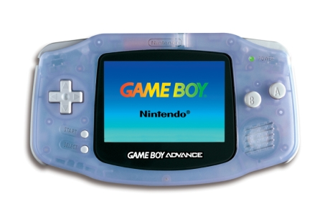

Gray Mail: User's View
I bought a Game Boy Advance at games.com
A week later, I started to receive advertising email…
Good Mail!
GBA Games
50% off!

Slide 4
Gray Mail: Another User's View
Alan bought a Game Boy Advance Game at games.com
A week later, Alan started to receive the same advertising email…
Junk Mail!
GBA Games
50% off!

Slide 5
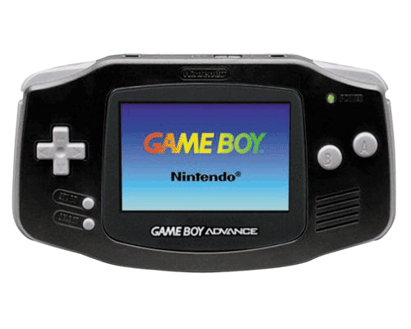
Gray Mail: System's View
GBA Games
50% off!
Black GBA
50% off!
GBA Games
50% off!
Black GBA
50% off!
We call these messages which users have different opinions gray mail.

Slide 6
Outline
Show that gray mail is common and difficult
Analysis done using Hotmail Feedback Loop data
Show how to deal with gray mail
we need to incorporate user preference
Propose a large-scale personalization algorithm
Partitioned Logistic Regression [Chang et al. KDD-08]
Lightweight and scalable
Catch 40% more spam in low FP area for gray mail
Improve spam filter with partial feedback

Slide 7
How Many Messages Are Gray Mail?
Dataset – Hotmail Feedback Loop
Hotmail messages labeled as good or spam
Obtained by polling over 100K users daily
Messages from Apr ~ May, 2007
Strategy: Campaign Detection
Campaign: a set of “almost identical” mail
Gray campaign: campaign that users disagree on the labels
Gray mail: messages in gray campaign

Slide 8
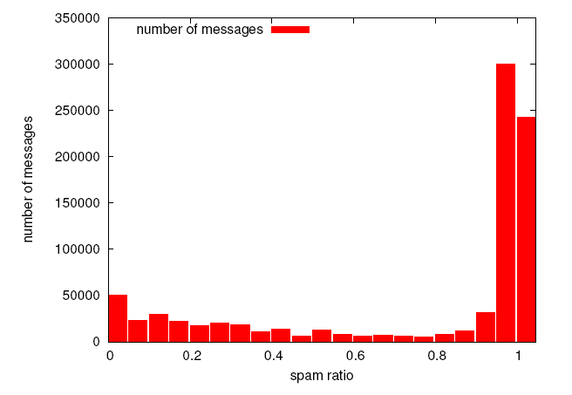
The Amount of Gray Mail
About 21% are Gray Mail !
About 8% are Gray Mail !

Slide 9
Gray Mail is Common and Difficult
There are quite a few gray messages
Gray mail detected by campaign occupy about 8% or 21% of all mail
Spam filtering for gray mail is difficult!
Messages in all campaigns
TPR@FPR=10% ~ 80%
Messages in gray campaigns
TPR@FPR=10% ~ 15% !!
We need to address the issue of gray mail!

Slide 10
A Label Noise Problem?
Major problem of gray mail: Noisy label ?
Past works show that removing noise improves some tasks significantly [Brodley and Friedl 99], [Lawrence and Schölkopf 01]
Clean label noise using campaign detection
For a given message, find the campaign it belongs to
Replace the label by the majority vote
Our verification procedure
We clean the label in the training data
Train a classifier on cleaned labeled data then test it
Training: Jan-Mar 07, Testing: Apr-May 07

Slide 11
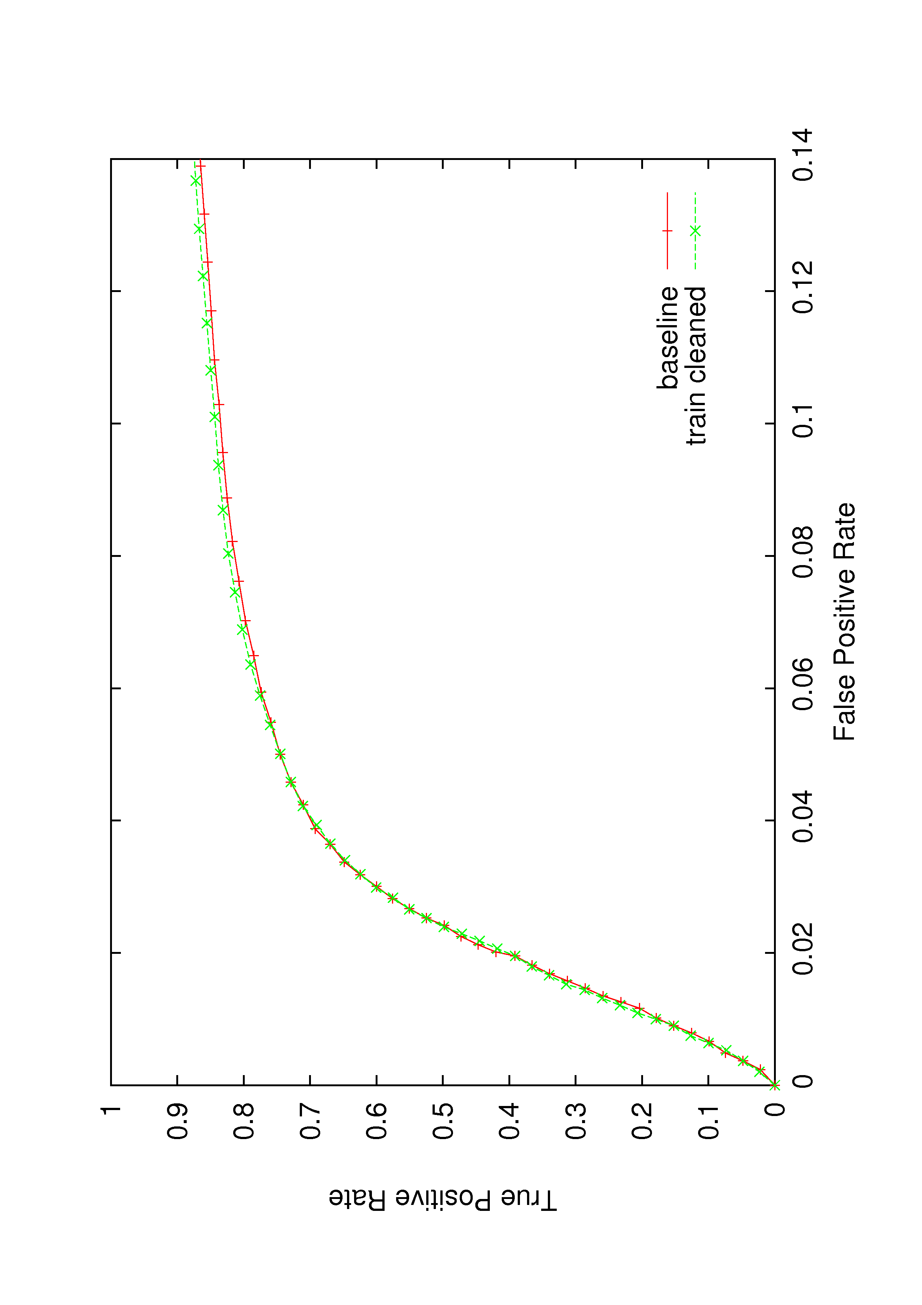
A Label Noise Problem?
Label cleaning brings limited improvement
The major problem: there are just no “right answers”
Alternative: incorporating user preference

Slide 12
Potential Gain from Incorporating User Preference
Is user preference the bottleneck?
Remove user preference in the testing data
Test on cleaned data, if we get huge improvement
The bottleneck is likely to be user preference
This analysis gives the potential upper bound of the gain of incorporating user preference
Procedure
Train a classifier with original labeled data
Test the classifier on cleaned testing data

Slide 13
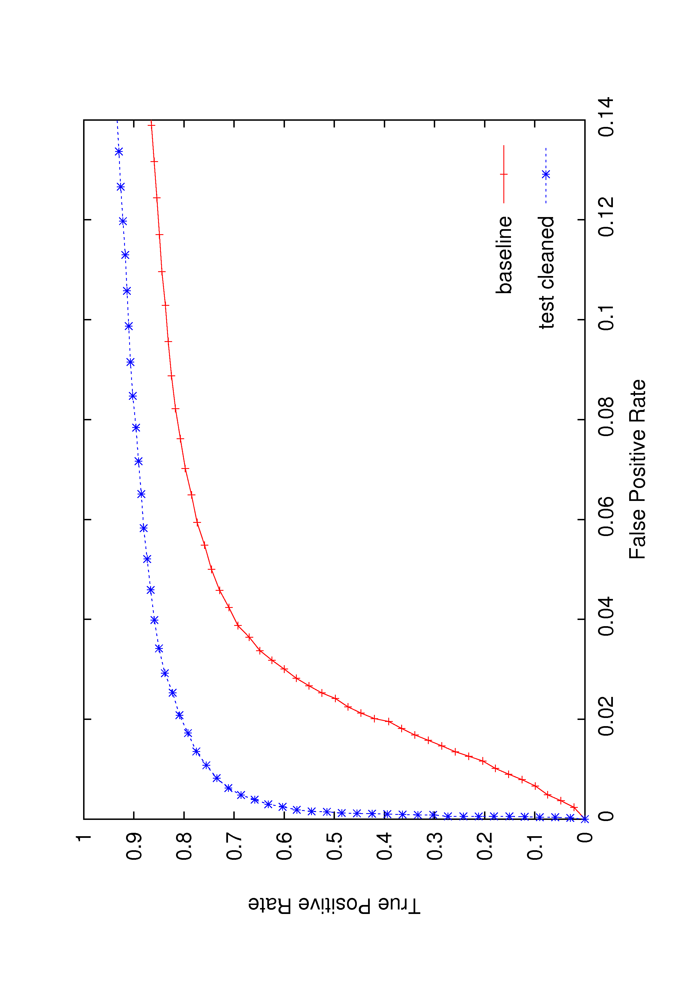
Clean the Test Data
Increase TP rate from ~55% to ~85%

Slide 14
Incorporate User Preference
Solution 1: User’s safe/block list
Require user’s participation
Need to modify the list for each new sender
Solution 2: Personalized spam filtering
Usually means building individual models using personalized training sets for each user [Segal 07]
Great potential, but hard to implement for large scale systems
Hotmail: >200 million users
Remove user preference in the testing data
Lack of labeled data from each user
Our solution: a lightweight personalization system
Does not require lots of user’s participation
Highly scalable

Slide 15
Make Personalization Tractable
On one hand, training a model with content information only
No user preference
On the other hand, training user specific content models
Intractable
Our solution: train content model and user model separately
Introduce a conditional independence assumption
Combine two models in the testing time
Training user model, , is relatively easy

Slide 16
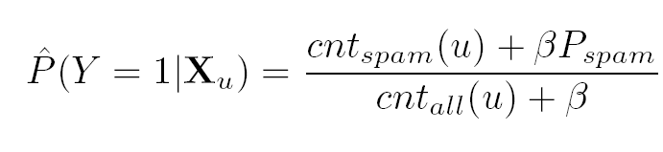
Implementation of User Models
For more details, check the paper and [Chang et al. KDD-08]
Global decision threshold:
Our model: lightweight personalization
Each user has his own threshold
User’s threshold can be derived from
:user id
Calculating threshold is easy

Slide 17
Experimental Setting
Training/Testing Split
From Jan, 2007 to Mar 2007 → Training
From Apr, 2007 to May 2007 → Testing
Focus on messages sent by mixed sender
Mixed Senders: Senders who send both good and spam mail
Test data: collection of the messages sent by mixed senders
A super set of gray mail. Also contain good and spam mail.
We want to test our algorithm on a large dataset
This dataset is hard: TPR @ FPR = 0.1 is 38.2%

Slide 18
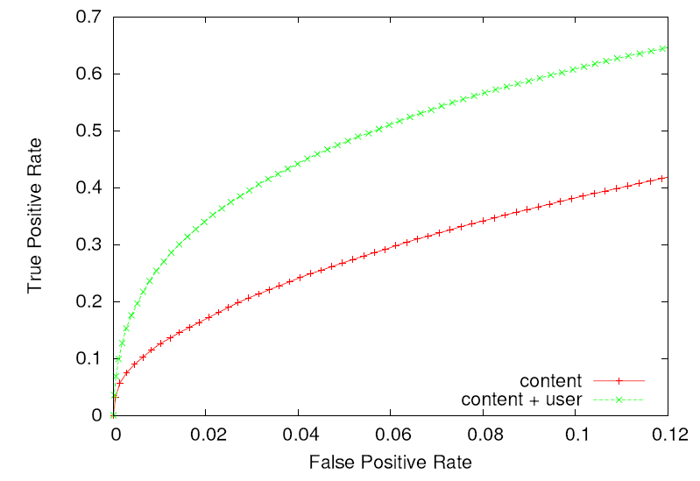
Results on Gray Mail (Mixed Sender)
TPR @ FPR=0.1 : 38.2% ➔ 60.8%,

Slide 19
Personalization with Partial Feedback
We can improve spam filtering significantly
By assigning a threshold to each user
The solution is scalable and easy to implement
But, it requires complete feedback from users
For most users, only partial feedback is available
Safe/block lists, junk mail reports, deleted mail
Given partial feedback, how much can we gain?

Slide 20
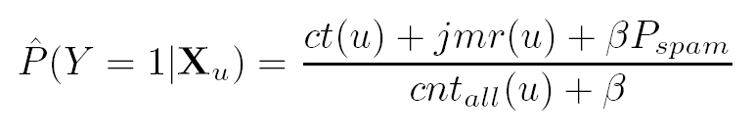
Improve Spam Filtering with Junk Mail Report
Junk mail report: report spam which appears in the inbox
In the simulation, we vary the report rate to get different level of partial feedback
The number of reported messages
The estimated number of successfully caught spam
The total number of messages sent to this user

Slide 21
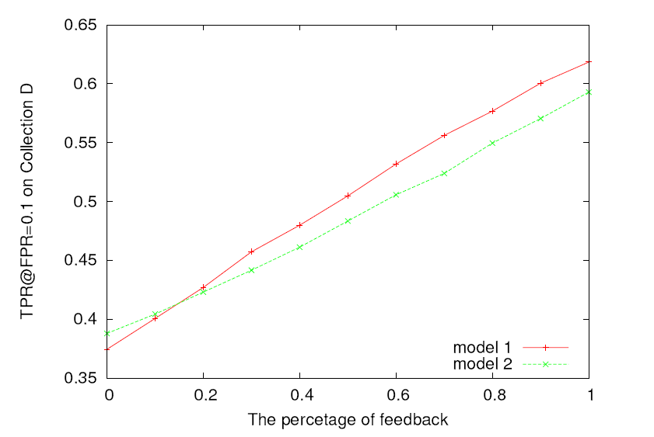
Partial Feedback Is Useful
TPR @ FPR=0.1 improves from 37 % to 43% with 20% report rate
The Report Rate of Misclassified Spam Mail

Slide 22
Conclusion
Gray mail is a common and difficult problem
We need to incorporate user preference to solve it
Our lightweight personalization algorithm
Simple, scalable and easy to implement
Complete feedback
TPR @ FPR=0.1 improves from 38.2% to 60.8%
Demonstrate that the model can be improved using partial feedback
Possible future work
Additional forms of feedback (black/white list, folding behavior)

